Slide 1
FLOOD PULSE AI
Predict. Prevent. Protect.
AI-Powered Urban Flood Prediction & Intelligent Emergency Response System
Vertical: AI for Smart Cities and Sustainability
Team Name: Nova Squad
Team Leader: Meghna Kotian
Team Members 1: Varshitha
Team Members 2: Navya
Team Members 3: Varsha .N

Slide 2
PROBLEM STATEMENT
Urban Flooding: A Critical Challenge for Smart Cities
Rapid urbanization, inadequate drainage infrastructure, and unpredictable weather patterns have significantly increased the occurrence of urban flooding. Most existing flood management systems are reactive, resulting in delayed emergency response, severe traffic congestion, and increased risks to public safety.
Key Challenges
Sudden flooding disrupts transportation and daily commuting.
Emergency services experience delays due to flooded roads.
Citizens lack access to real-time flood information and safe navigation.
Municipal authorities have limited visibility into flood-prone locations.
Absence of predictive intelligence leads to delayed decision-making.
Need for the Solution
A smart city requires a predictive and data-driven flood management system that enables authorities to respond proactively while providing citizens with timely alerts and safer travel routes.

Slide 3
PROPOSED SOLUTION
Flood Pulse AI is an AI-powered web and mobile application designed to predict urban flooding and support intelligent emergency response.
The platform integrates weather forecasts, IoT water-level sensors, satellite and GIS data, and historical flood records to identify flood-prone areas before flooding occurs.
Core Functionalities
AI-based flood prediction using real-time and historical data.
Live flood-risk mapping for affected regions.
Safe route navigation based on current road conditions.
Instant emergency alerts for citizens and authorities.
AI-assisted drain blockage detection.
Citizen reporting system with GPS-enabled incident reporting.
Centralized dashboard for municipal authorities.
Objective
To shift urban flood management from reactive response to proactive prediction through real-time intelligence and data-driven decision-making.

Slide 4
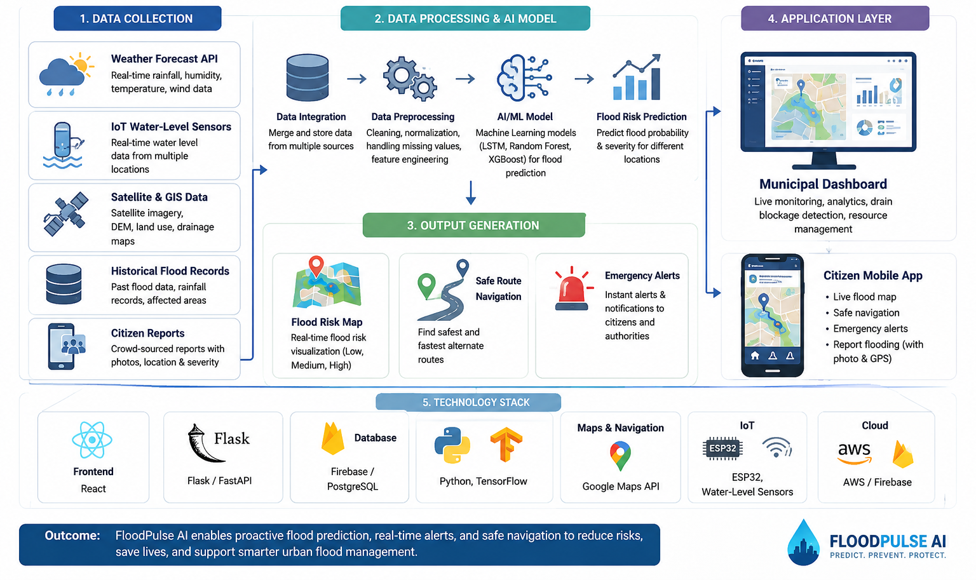
TECHNICAL APPROACH

Slide 5
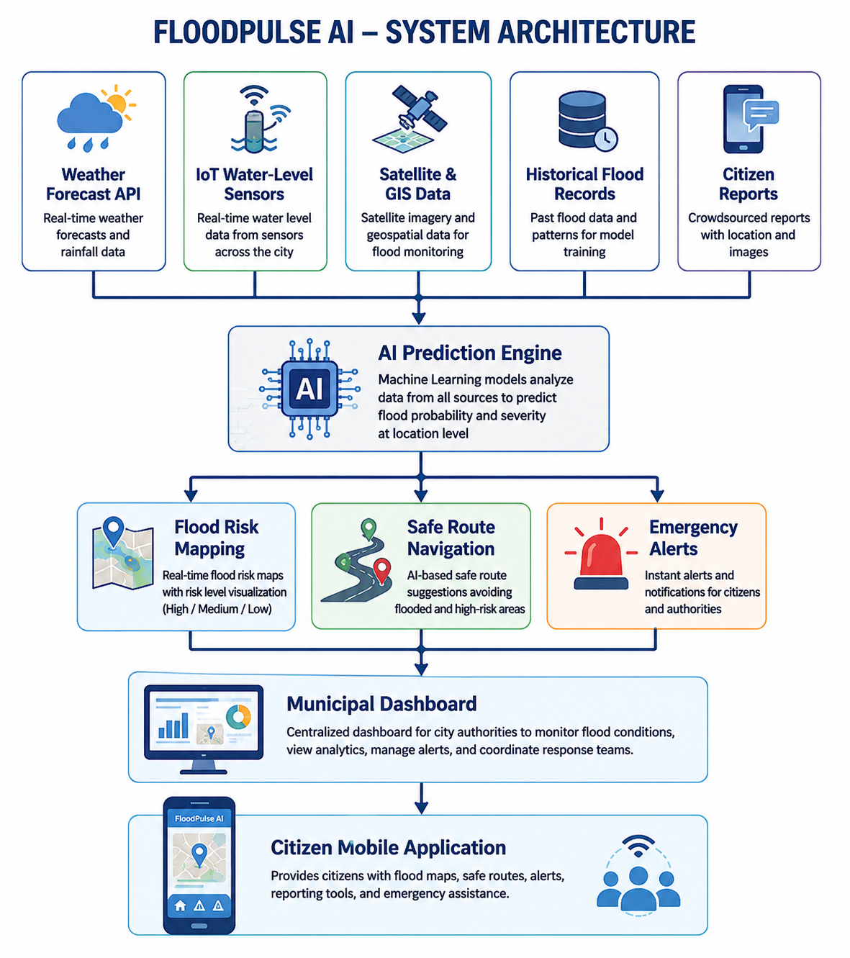
SYSTEM ARCHITECTURE
System Components
Weather Forecast API
IoT Water-Level Monitoring
GIS and Satellite Data
AI Prediction Engine
Web Dashboard
Mobile Application
Emergency Notification System
Citizen Reporting Module

Slide 6
KEY FEATURES & TECHNOLOGY STACK
KEY FEATURES:
AI Flood Prediction – Predicts flood-prone areas using AI and real-time data.
Flood Risk Mapping – Displays live flood severity on an interactive map.
Smart Navigation – Suggests safe alternative routes during flooding.
Emergency Alerts – Sends instant warnings to citizens and authorities.
Citizen Reporting – Enables GPS-based flood reporting with photos.
Municipal Dashboard – Real-time monitoring and emergency management.
TECHNOLOGY STACK:
Frontend: React
Backend: Flask
AI: Python, TensorFlow
Database: Firebase
Maps: Google Maps API
IoT: ESP32 Sensors
Cloud: AWS

Slide 7
IMPACT AND INNOVATION
Innovation
Flood Pulse AI combines Artificial Intelligence, IoT, geospatial mapping, and citizen participation into a single integrated platform capable of predicting urban floods before they occur.
Unlike conventional flood monitoring systems that respond after flooding begins, Flood Pulse AI enables proactive decision-making through continuous monitoring and predictive analytics.
Expected Impact
Reduced response time during emergencies.
Improved public safety through early warning systems.
Optimized traffic management using safe route recommendations.
Better coordination between citizens and municipal authorities.
Data-driven planning for future urban infrastructure.
Target Users
Municipal Corporations
Disaster Management Authorities
Emergency Response Teams
Smart City Administrators
General Public

Slide 8
FUTURE SCOPE
Future Enhancements
Drone-based flood surveillance for inaccessible areas.
AI-powered rainfall forecasting with improved prediction accuracy.
Integration with Smart City Command and Control Centers.
Digital Twin simulation for flood planning and infrastructure management.
Multilingual voice-based emergency notifications.
Automated emergency resource allocation using predictive analytics.
Conclusion
Flood Pulse AI provides an intelligent, scalable, and practical solution for urban flood management by leveraging Artificial Intelligence, IoT, and real-time data analytics. The platform enhances disaster preparedness, improves emergency response, and contributes to building resilient and sustainable smart cities.

Slide 9
THANK YOU

